Slide 1
The Bride’s Enlarged Vision
Lesson 23
Song of Solomon 2:17
Song of Solomon Study
By Rev. James R. Reynolds, Sr.

Slide 2
Song of Solomon Lessons
#19: A Message from the Bridegroom
#20: Panorama of the Bride
#21: Keeping the Vineyard
#22: The Bride’s Developing Insight
#23: The Bride’s Enlarged Vision

Slide 3
Song of Solomon 2:1-4
Song 2:1 ¶ I am the rose of Sharon, and the lily of the valleys.
2 As the lily among thorns, so is my love among the daughters.
3 ¶ As the apple tree among the trees of the wood, so is my beloved among the sons. I sat down under his shadow with great delight, and his fruit was sweet to my taste.
4 He brought me to the banqueting house, and his banner over me was love.

Slide 4
Song of Solomon 2:5-9
5 Stay me with flagons, comfort me with apples: for I am sick of love.
6 His left hand is under my head, and his right hand doth embrace me.
7 I charge you, O ye daughters of Jerusalem, by the roes, and by the hinds of the field, that ye stir not up, nor awake my love, till he please.
8 ¶ The voice of my beloved! behold, he cometh leaping upon the mountains, skipping upon the hills.
9 My beloved is like a roe or a young hart: behold, he standeth behind our wall, he looketh forth at the windows, shewing himself through the lattice.

Slide 5
Song of Solomon 2:10-13
10 My beloved spake, and said unto me, Rise up, my love, my fair one, and come away.
11 For, lo, the winter is past, the rain is over and gone;
12 The flowers appear on the earth; the time of the singing of birds is come, and the voice of the turtle is heard in our land;
13 The fig tree putteth forth her green figs, and the vines with the tender grape give a good smell. Arise, my love, my fair one, and come away.

Slide 6
Song of Solomon 2:14-16
14 O my dove, that art in the clefts of the rock, in the secret places of the stairs, let me see thy countenance, let me hear thy voice; for sweet is thy voice, and thy countenance is comely.
15 Take us the foxes, the little foxes, that spoil the vines: for our vines have tender grapes.
16 My beloved is mine, and I am his: he feedeth among the lilies.

Slide 7
TEXT: Song of Solomon 2:17
Until the day break, and the shadows flee away, turn, my beloved, and be thou like a roe or a young hart upon the mountains of Bether.

Slide 8
The Bride’s Enlarged Vision
Text: Song of Solomon 2:17
Introduction
I. Bride’s Ultimate Hope
II. Bride’s Prevailing Prayer
III. Bride’s Present Condition

Slide 9
Introduction
Her knowledge and insight into the things of God are developing as she walks with God.
You are not going to understand the deeper things of God unless you walk consistently with Him.
Truth is not going to come to one that is not walking with the Lord.

Slide 10
Introduction
John 7:17—If any man will do his will, he shall know of the doctrine, whether it be of God, or whether I speak of myself.
Matthew 6:23—But if thine eye be evil, thy whole body shall be full of darkness. If therefore the light that is in thee be darkness, how great is that darkness!

Slide 11
Introduction
It is necessary that we grow and advance not only in Revelation but in Experience.
We have ceased to grow and develop when we cease to apply the truth and walk in it.
All Revelation comes from the Word of God.
God’s ultimate Eternal Purpose is that He might have a Bride that is one with Him.
Eph. 3:11;

Slide 12
Introduction
Ephesians 3:11—According to the eternal purpose which he purposed in Christ Jesus our Lord:
John 17:22—And the glory which thou gavest me I have given them; that they may be one, even as we are one:

Slide 13
Introduction
SOS 1:5—I am black, but comely, O ye daughters of Jerusalem, as the tents of Kedar, as the curtains of Solomon.
SOS 2:4,5—He brought me to the banqueting house, and his banner over me was love. 5 Stay me with flagons, comfort me with apples: for I am sick of love.
Her hunger has not decreased but increased.

Slide 14
Introduction
Her vision is enlarging because she is going on. As you go on in God He is going to reveal more to you.
The vision of the advancing train: “Watch the Light.”

Slide 15


“Watch the Light”

Slide 16
Introduction
We should be developing with a determination to reach the Goal.
Hebrews 6:1—Therefore leaving the principles of the doctrine of Christ, let us go on unto perfection; not laying again the foundation of repentance from dead works, and of faith toward God,

Slide 17
Introduction
Even though her vision has enlarged there is a crying out for help.
Titus 2:13—Looking for that blessed hope, and the glorious appearing of the great God and our Saviour Jesus Christ;

Slide 18
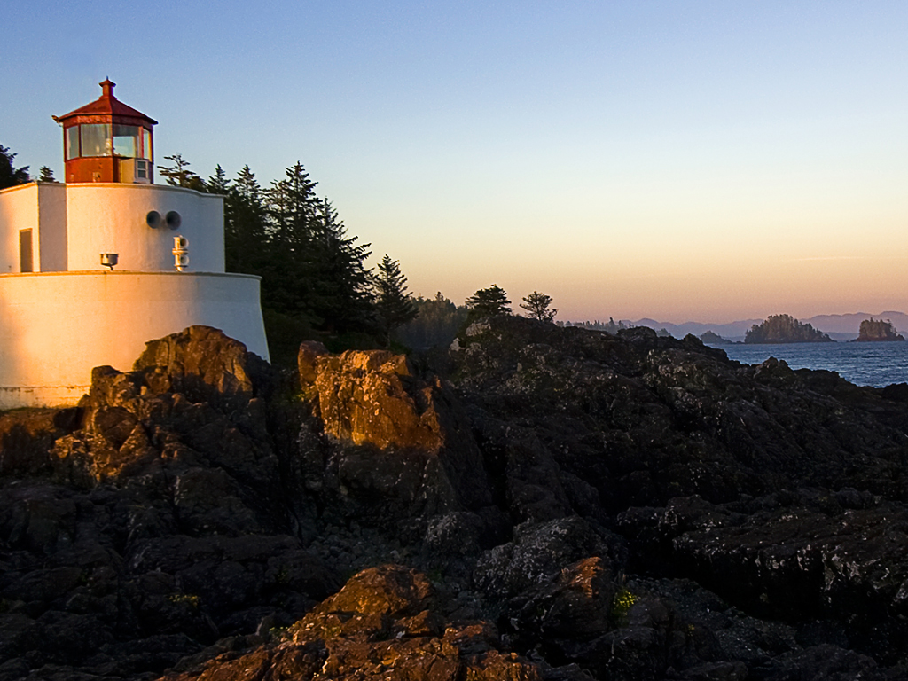
Introduction “The Eternal Day break”

Slide 19
Introduction “The Eternal Day break”
Job 28:7—There is a path which no fowl knoweth, and which the vulture's eye hath not seen:
John 21:3—Simon Peter saith unto them, I go a fishing
Peter lost his vision.
We need a proper understanding of what God is doing.

Slide 20
Introduction “The Eternal Day break”
SOS 2:17—Until the day break, and the shadows flee away, turn, my beloved, and be thou like a roe or a young hart upon the mountains of Bether.
“until” talking about a time that is coming but is far beyond where she is right now.

Slide 21
The Bride’s Enlarged Vision
Text: Song of Solomon 2:17
Introduction
I. Bride’s Ultimate Hope
II. Bride’s Prevailing Prayer
III. Bride’s Present Condition

Slide 22
I. Bride’s Ultimate Hope
“Until the day break, and shadows flee away…”
The Night

Slide 23
I. Bride’s Ultimate Hope A. The Night
Night Speaks of Separation.
When He is not there, it is night.
John 8:12—Then spake Jesus again unto them, saying, I am the light of the world: he that followeth me shall not walk in darkness, but shall have the light of life.

Slide 24
I. Bride’s Ultimate Hope A. The Night
Night Speaks of Separation.
When He is not there, it is night.
It is night in the Church.
Revelation 3:20—Behold, I stand at the door, and knock: if any man hear my voice, and open the door, I will come in to him, and will sup with him, and he with me.

Slide 25
I. Bride’s Ultimate Hope A. The Night
Night Speaks of Separation.
When He is not there, it is night.
It is night in the Church.
It is night for the Bride presently, but because she is progressing on in the Lord, she is beginning to get a vision of better things.

Slide 26
I. Bride’s Ultimate Hope A. The Night
Night Speaks of Separation.
Night Speaks of Sin.
Anything that licenses sin is of the devil.

Slide 27
Ultimate Goal to Run After
We do have weaknesses, but our goal is God’s Eternal Purpose.
I Corinthians 15:57,58—But thanks be to God, which giveth us the victory through our Lord Jesus Christ. 58 Therefore, my beloved brethren, be ye stedfast, unmoveable, always abounding in the work of the Lord, forasmuch as ye know that your labour is not in vain in the Lord.

Slide 28
Ultimate Goal to Run After
We do have weaknesses, but our goal is God’s Eternal Purpose.
II Corinthians 2:14—Now thanks be unto God, which always causeth us to triumph in Christ, and maketh manifest the savour of his knowledge by us in every place.

Slide 29
I. Bride’s Ultimate Hope A. The Night
Night Speaks of Separation.
Night Speaks of Sin.
Anything that licenses sin is of the devil.
Romans 1:25—Who changed the truth of God into a lie, and worshipped and served the creature more than the Creator, who is blessed for ever. Amen.

Slide 30
Romans 13:12-14
12 The night is far spent, the day is at hand: let us therefore cast off the works of darkness, and let us put on the armour of light.
13 Let us walk honestly, as in the day; not in rioting and drunkenness, not in chambering and wantonness, not in strife and envying.
14 But put ye on the Lord Jesus Christ, and make not provision for the flesh, to fulfil the lusts thereof.

Slide 31
I. Bride’s Ultimate Hope A. The Night
Night Speaks of Separation.
Night Speaks of Sin.
Night Speaks of Death.
John 9:4—I must work the works of him that sent me, while it is day: the night cometh, when no man can work.

Slide 32
I. Bride’s Ultimate Hope A. The Night
Night Speaks of Separation.
Night Speaks of Sin.
Night Speaks of Death.
There is a time when you will not be able to avail to yourself what is provided.

Slide 33
FALSE
A lot of people believe only that there is going to be a wonderful transformation ONLY after we leave this world.
NOW IS THE TIME TO WORK.

Slide 34
Matthew 16:18
And I say also unto thee, That thou art Peter, and upon this rock I will build my church; and the gates of hell shall not prevail against it.

Slide 35
I. Bride’s Ultimate Hope
“Until the day break, and shadows flee away…”
The Night
The Day

Slide 36
I. Bride’s Ultimate Hope B. The Day
John 11: 24,25—Martha saith unto him, I know that he shall rise again in the resurrection at the last day. 25 Jesus said unto her, I am the resurrection, and the life: he that believeth in me, though he were dead, yet shall he live:
There is a day wholly of light and no darkness at all. (I John 1:5)

Slide 37
I. Bride’s Ultimate Hope B. The Day
John 11: 24,25—…I am the resurrection, and the life…
There is a day wholly of light and no darkness.
Philippians 3:10—That I may know him, and the power of his resurrection, and the fellowship of his sufferings, being made conformable unto his death;

Slide 38
I. Bride’s Ultimate Hope B. The Day
Day Speaks of Light.

Slide 39
I. Bride’s Ultimate Hope B. The Day
Day Speaks of Light.
Day Speaks of Truth.
People are entertaining things that may not be altogther true—some very strange doctrinal points, but we must strive for unity of the Spirit.
Eph. 4:3,13; Rom. 10:17; Eph. 4:14

Slide 40
Ephesians 4:3,13
3 Endeavouring to keep the unity of the Spirit in the bond of peace.
13 Till we all come in the unity of the faith, and of the knowledge of the Son of God, unto a perfect man, unto the measure of the stature of the fulness of Christ:

Slide 41
Romans 10:17
So then faith cometh by hearing, and hearing by the word of God.

Slide 42
Ephesians 4:14
That we henceforth be no more children, tossed to and fro, and carried about with every wind of doctrine, by the sleight of men, and cunning craftiness, whereby they lie in wait to deceive;

Slide 43
Are there children in the Church?
Many preachers are unwise with money.
Joh 2:16—And said unto them that sold doves, Take these things hence; make not my Father's house an house of merchandise.
Mt 21:13—And said unto them, It is written, My house shall be called the house of prayer; but ye have made it a den of thieves.

Slide 44
Even thought there is Darkness…
When we see all of this darkness,
In the midst of it all,
there is a light about to break.

Slide 45
I. Bride’s Ultimate Hope B. The Day
Day Speaks of Light.
Day Speaks of Truth.
Day Speaks of Righteousness.
Revelation 13:12; 19:7

Slide 46
Can you walk in righteousness?
YES, the Bible says so.
When is the Bride going to wear robes of white?
NOW, in this present world.
Rom. 13:12—The night is far spent, the day is at hand: let us therefore cast off the works of darkness, and let us put on the armour of light.

Slide 47
3. Day Speaks of Righteousness
Revelation 19:7,8—Let us be glad and rejoice, and give honour to him: for the marriage of the Lamb is come, and his wife hath made herself ready. 8 And to her was granted that she should be arrayed in fine linen, clean and white: for the fine linen is the righteousness of saints.

Slide 48
The Bride’s Enlarged Vision
Text: Song of Solomon 2:17
Introduction
I. Bride’s Ultimate Hope
II. Bride’s Prevailing Prayer
III. Bride’s Present Condition

Slide 49
II. Bride’s Prevailing Prayer
“…turn, my beloved, and be thou like a roe or a young hart…”
Her vision drives her to prayer.
Vision will produce real prayer.
The Content of Her Prayer

Slide 50
II. Bride’s Prevailing Prayer A. The Content of Her Prayer
“…turn, my beloved…”
“turn” turn back
She begs for her beloved’s return to her. She needs Him:
To Lead Her
To Support Her
To Encourage Her

Slide 51
1Pe 5:8 ¶ Be sober, be vigilant; because your adversary the devil, as a roaring lion, walketh about, seeking whom he may devour:

Slide 52
II. Bride’s Prevailing Prayer
“…turn, my beloved, and be thou like a roe or a young hart…”
Her vision drives her to prayer.
The Content of Her Prayer
The Urgency of Her Prayer

Slide 53
II. Bride’s Prevailing Prayer B. The Urgency of Her Prayer
“…And be thou like a roe or a young hart…”
Come Swiftly – “like a roe”
Bring Hope – “ or a young hart”
Turn the darkness.

Slide 54
Re 22:20 ¶ He which testifieth these things saith, Surely I come quickly. Amen. Even so, come, Lord Jesus.

Slide 55
You can be in the rapture and endure the tribulation hour.
The church is going to be here.

Slide 56
You can be in the rapture and endure the tribulation hour.
The church is going to be here.
Do a quick work!

Slide 57
Ps 22:1 ¶ <<To the chief Musician upon Aijeleth Shahar, A Psalm of David.>
Aijeleth Shahar – “hind/hart/deer of the dawn”

Slide 58
The Bride’s Enlarged Vision
Text: Song of Solomon 2:17
Introduction
I. Bride’s Ultimate Hope
II. Bride’s Prevailing Prayer
III. Bride’s Present Condition

Slide 59
She has become Aware of Her Condition
Someone tells you how you are and you get upset or retaliate.
We don’t listen to our neighbors.
We don’t listen to what the watchmen say.
You will respond to…
When you see it for yourself by the ministry of the Spirit!

Slide 60
There is a vast difference between the Spirit touching places in our lives than just a preacher or a friend.

Slide 61
III. Bride’s Present Condition
“…upon the mountains of Bether.”
Bether means division or separation.
The Bride has some mountains that have caused separation.

Slide 62
Indifference
First Sunday preaching at the church.
I came fired up.
“Help us not get too excited about this thing.”
Who shall separate us from the love of God?
I can separate myself by my own indifference.

Slide 63
III. Bride’s Present Condition What caused the mountains?
Indifference
Unfaithfulness
Self-willed
Unbelief
Slothfulness
Jesus come to us on our mountains and help us!

Slide 64
Unfaithfulness
Not necessarily outright rebellion, but little by little.
God is faithful.
Tell Jacks on I would like to see him. So he travelled all night long…General Jackson reporting for duty. Your slightest wish is my supreme order.

Slide 65
Self-Willed
I will do as I want and no one will tell me different.
The little Bride will not have this kind of attitude.

Slide 66
Unbelief
Unbelief is the greatest hindrance you will face in life.
“Chain Letters.” I tear it up and challenge the devil to do anything about it.
To fear is to believe it. To fear involves negative. Faith involves truth.
We have so much confidence in the things that we fear.
Under Ladder, broken mirrors, superstition

Slide 67
Unbelief
FAITH NOT FEAR!
Believe God and the devil cannot hurt you.
Tear up those chain letters.
Greater is He that is in you.
1 John 4:4 ¶ Ye are of God, little children, and have overcome them: because greater is he that is in you, than he that is in the world.t is in you!

Slide 68
The Bride’s Enlarged Vision
Text: Song of Solomon 2:17
Introduction
I. Bride’s Ultimate Hope
II. Bride’s Prevailing Prayer
III. Bride’s Present Condition

